Slide 1
Innoscripta Data Scraping Hackathon

Slide 2
General Challenges
Biggest challenge was to find a data source ☺
Our country was changed from Brazil to Sweden on 1st of March.
I found data source on the same day.
Team
I had access to my data source (globaldatabase.com) on 2023-03-01_20:58.
I lost access to my data source on 2023-13-01.
Account was probably locked or banned due to over use.
So, I had only 10 days for both developing the program and scraping the data.

Slide 3
Coding Challenges
All data is displayed in one page:
You need to scroll down to load new data rows.
Particularly coded.
Memory overload
Scraped data rows are particularly deleted from html via code.
Program restarts itself when filter is needed to be changed.
Even if you keep scrolling down, more than about 10k rows are not loaded.
Solution: Effective use of filters.
Employee number of company is a good filter, but not enough.
My 1st approach was to go region by region.
2nd one was to use ‘corporation date start and end’ filters.
You need to click to see phone number and email address.
Particularly clicked via code.
Resizing browser windows was needed and done via code.
Particularly coded.

Slide 4
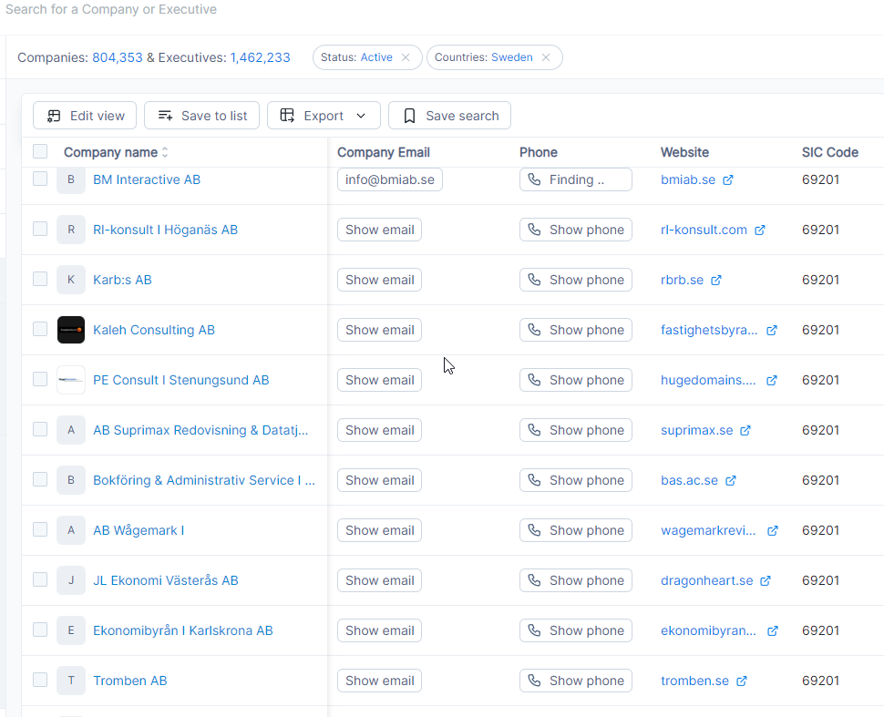

Slide 5
Achievements
I managed to scrape 170 663 data rows accurately.
And 1290 rows with missing phone number or/and email address.
So, overall data accuracy in scraping is around %99.
However, I increased accuracy up to %99.9 after I updated my code.
Data Coverage
CompanyName
CompanyEmail
Phone
Website
SICCode
VatNumber
SICDescription
Industry
LegalForm
RegistrationNo
Address
AlexaRank
MonthlyVisits
EmployeeNumber
TurnOver
Age

Slide 6
Technologies I Used
Programming language: C#
Library for scraping: Selenium
Database: MS-SQL Server.
I developed 2 versions. Both are fully automated.
1st one is able to run fully functional 7/24.
2nd one was built based on 1st edition.
Major difference: different filtering parameters are used.
I lost access to data source when I was testing 2nd version.
Technical Details

Slide 7
Details of Version 1
Main function of program takes 3 arguments:
Minimum number of employee
Maximum number of employee
Region index
Total region count is detected by the program and region index is handled automatically.
When we run program:
Each region is iterated with the current employee number interval.
Then, employee number changes and region index starts from beginning.
After each iteration, program restarts itself with new parameters/filters.
To free memory use
To be able to load new filters without crash

Slide 8
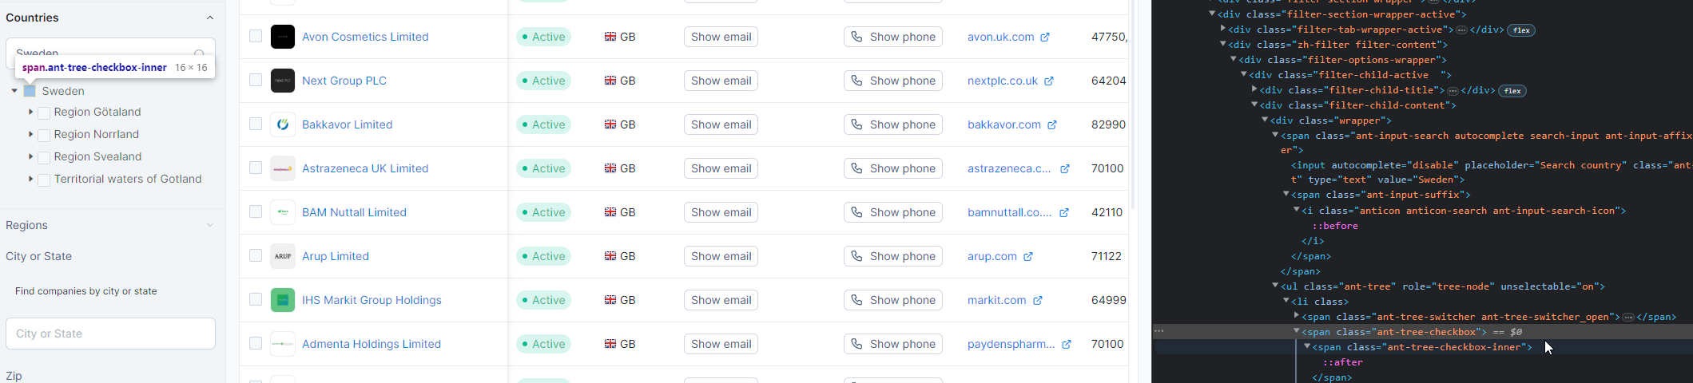

Slide 9
Details of Version 2 (Beta)
Main function of program takes 3 arguments:
Index of tuple list where minimum and maximum employee numbers are held.
Corporation start date of last iteration, that date will be set as end date of next iteration. And start date of new iteration is calculated automatically.
Specifically calculated corporation date interval, brings data in the amount that you want. I set it to ‘less than 7000’.
And a Boolean that basically indicates either to change date interval or employee number.
Region is not used for filtering anymore because some countries aren’t displayed under any region.
Corporation date could be the best choice as filter. For crucial reasons:
We can change date interval as we wish and bring as many as data we want.
All data rows belong to some date interval, so all data can be scraped without loss.
I really wish I had access to data source for longer time, so I could finish it.

Slide 10
Thank you for listening
Future Improvements
Optimizing the scraping speed.
I.e. Click ‘show phone’ and ‘show email’ buttons 10 by 10, instead of 1 by 1.
Re-factoring the code to make it easier to read.
Moving hard-coded values such as login credentials, filters: country name, minimum-maximum employee numbers list etc. to outside of the program. So program would become more generic.

